Slide 1
R Training 1
Dennis Wollersheim

Slide 2
Summary
What do you know about R?
What is hard about R?
What do you want to know?
What do I know about R?

Slide 3
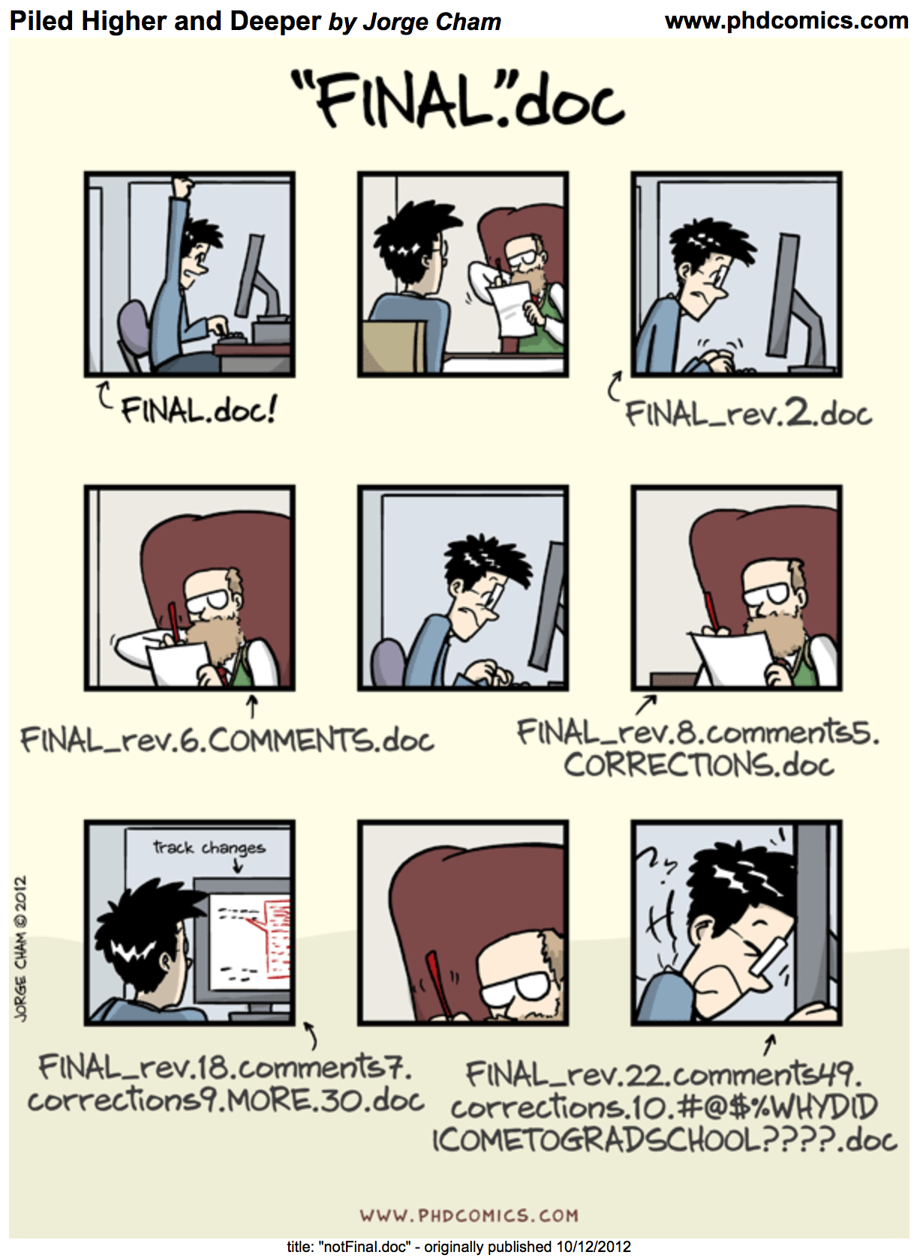
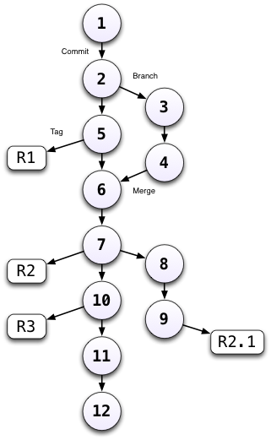
GIT
Version control
Documentation
Rollback
Blame
Collaboration

Slide 4
Clone a repository!
https://github.com/dewoller/standard_setup.git

Slide 5
Visualisation
https://r4ds.had.co.nz/data-visualisation.html
Using the ideas from this page, make visualisations with *our* data. For example, using Linelist

Slide 6
Pitfalls – Namespace conflicts
e.g. summarise
library(tidyverse)
library(Hmisc)
mpg %>%
group_by( manufacturer) %>%
summarize( displ = mean( displ)) Solution
library(conflicted)

Slide 7
Pitfall #2 - overwrite variables
What version of variables are you looking at
data <- read_csv(‘data_file.csv’)
data <- data %>% filter( sex==‘M’)
Solution
data <- read_csv(‘data_file.csv’)
data_male <- data %>% filter( sex==‘M’)

Slide 8
Pitfall #3 – Hard to understand code
Short code - Code should not be more than 1 screen long
Lines should not be more than 1 screen wide
Indentation and spacing standards
How - Modularisation

Slide 9
Modularisation - Functions
my_function <- function( x ) {
sqrt( x )
}

